Slide 1



×
● Premium Member Masterclass
Monday 19 October · 19:00 UK / 20:00 CET
Predicting Match and
Season Outcomes
Betting odds, a goal model, and 10,000 simulated seasons:
every team's chance of every final league position.
Victoria Friss de Kereki
Football Data Analyst @ SkillCorner
Creator of the Football League Simulator
football-league-simulator.streamlit.app

Slide 2


Hi, I'm Vicky
WHO'S TALKING
FROM FINANCE TO FOOTBALL
Years in Finance + BI, a lot of it around fintech, then all in on football
LEARNING
MSc Finance (2023) · MSc Data Science & Analytics (2024)
Context Engineering course with Twelve (2026)
CURRENTLY
Football Data Analyst @ SkillCorner since June 2026
SIDE PROJECTS
Football analytics on Medium + tonight's 9-league simulator
OFF THE PITCH
Weightlifting, strongwoman, CrossFit… and rugby (recovering post-ACL surgery)
9
10,000
225
leagues simulated
seasons per league, per run
days running live, every day since Mar 2026

Slide 3
What we'll build tonight
TONIGHT
01
The one idea
Distributions, not predictions
02
Building the model
Odds, Poisson, ratings, shrinkage, promoted teams, win/draw/loss
03
Simulating the season
Monte Carlo: 10,000 seasons in a tenth of a second
04
Does it work?
Last season's calls, calibration, and what broke in production
05
Q&A
Your questions

Slide 4
Stop asking “who will win?” Ask “how likely?”
01 · THE ONE IDEA
POINT PREDICTION
“Man City will win the league.”
PROBABILITY DISTRIBUTION
“Man City: 59% to finish 1st, 31% 2nd, >99% top four… and Arsenal still win it 35% of the time.”
One simulated season is one sample. The useful part is the spread.
How close is 2nd? How real is the drop zone? A single ranking throws that away.

Slide 5
The whole pipeline on one slide
02 · BUILDING THE MODEL
Fixtures
1
2
3
4
Betting odds
→
Team ratings
→
Match probabilities
→
Monte Carlo
→
Distribution
attack & defence per team
from goals, plus shrinkage
home / draw / away
market if priced, else model
10,000 full seasons
simulated at once
P(every team,
every position)
Match history
Current table
The current table never enters the probability model. It's the starting state: every simulated season begins from today's points and goal difference, and only the remaining fixtures are played out.

Slide 6
Betting odds are a forecast with a margin baked in
STEP 1 · THE MARKET
Aston Villa v Manchester City · 24 Oct · one UK bookmaker
 | Home | Draw | Away | Sum
Decimal odds | 4.75 | 4.20 | 1.60
1 / odds | 21.1% | 23.8% | 62.5% | 107.4%
De-vigged (÷ the sum) | 19.6% | 22.2% | 58.2% | 100%
They add up to 107.4%, not 100%. The extra 7.4% is the bookmaker's margin (the “vig”). Averaged over ~12 bookmakers: 22% / 23% / 55%.
Why use the market at all? It prices in what a goals model can't see: injuries, team news, rotation.
1 / odds (sums to ~107%) → divide by the row sum → average the bookmakers
raw = 1 / odds[["home_odds", "draw_odds", "away_odds"]]
book = raw.div(raw.sum(axis=1), axis=0)
market = book.groupby([odds.home_team, odds.away_team]).mean()

Slide 7
Why we can model goals with a Poisson distribution
STEP 2 · GOALS AS A COUNT
Goals are rare and arrive one at a time over 90 minutes: close to the textbook Poisson setting (calls to a help desk, buses at a stop).
One number gives the whole shape: the average rate λ. Know λ and you know P(0 goals), P(1), P(5)…
An approximation, not a law: real goal counts are a little more spread out, and the two teams' goals are slightly linked. Close enough to build on.
P(k goals) = λᵏ · e^{−λ} / k!
Next step: estimate a λ for each team in each match. For Aston Villa v Manchester City: λ = 1.47 vs 1.9.

Slide 8
Every λ is built from four numbers
STEP 3 · TEAM RATINGS
λ_{home} = league avg × attack(home) × defence(away) × home adv
WORKED EXAMPLE · Manchester City away at Aston Villa
1.39
×
1.38
×
1.00
=
1.90
league average goals
per team per game
Man City attack
(1.0 = average)
Aston Villa defence
(above 1 = leakier)
goals Man City
expect to score (λ)
condensed from 3_probabilities.py · this season + last, recent games count up to 2× · _w = weighted · 1.0 = average
w = np.linspace(1, 2, len(matches))
attack = goals_for_w / games_w / league_avg
defence = goals_against_w / games_w / league_avg
home_adv = np.exp(weighted_mean(home_goals - away_goals, w)) # ×1.35

Slide 9
7 games in, how much should we trust a rating?
STEP 4 · SMALL SAMPLES
Early-season ratings are noisy. A lucky 4–0 swings a 7-game average enormously.
So pull every rating towards a sensible target, and fade the pull out as evidence arrives.
Two starting points. Established teams keep 50% of their raw rating from day one (last season counts); promoted and relegated teams start at 10%. Both reach full trust at half a season: one game against every other team (19 in the Premier League).
half season (19 games in the PL)
start: 0.5 established, 0.1 promoted · target: 1.0 or the prior
half = n_teams - 1 # 19 in the PL
trust = start + (1 - start) * (games / half).clip(upper=1)
attack = target + trust * (attack - target)
Today (7 games): established keep 68% · promoted 43%

Slide 10
Promoted teams aren't average, so don't shrink them to it
STEP 5 · A SHARPER TARGET
RELEGATED INTO A LEAGUE
PROMOTED INTO A LEAGUE
n = 3, into the 2025/26 Championship
n = 14, big-5 leagues, 2025/26
×1.22
×0.95
×0.81
×1.18
attack
goals conceded
attack
goals conceded
Ipswich and Southampton outscored the league average; Leicester didn't. Only 3 teams: a direction, not a precise number
All 14 scored below their new league's average, and 12 of 14 conceded more
This season: Coventry City, Hull City, Ipswich Town started 2026/27 shrunk towards the promoted-team target, not the league average. Same shrinkage weight, sharper target.

Slide 11
From two rates to every possible scoreline
STEP 6 · SCORELINES
Villa ↓ Man City → | 0 | 1 | 2 | 3 | 4 | 5 | 6
0 | 3.4 | 6.5 | 6.2 | 3.9 | 1.9 | 0.7 | 0.2
1 | 5.0 | 9.6 | 9.1 | 5.8 | 2.8 | 1.0 | 0.3
2 | 3.7 | 7.0 | 6.7 | 4.2 | 2.0 | 0.8 | 0.2
3 | 1.8 | 3.4 | 3.3 | 2.1 | 1.0 | 0.4 | 0.1
4 | 0.7 | 1.3 | 1.2 | 0.8 | 0.4 | 0.1 | <0.1
5 | 0.2 | 0.4 | 0.4 | 0.2 | 0.1 | <0.1 | <0.1
6 | <0.1 | 0.1 | 0.1 | 0.1 | <0.1 | <0.1 | <0.1
the whole grid in one line · independence
grid = np.outer(poisson.pmf(range(7), lam_home),
poisson.pmf(range(7), lam_away))
# P(2–1) = P(home scores 2) × P(away scores 1)
% chance of each exact score · rows: Aston Villa goals, columns: Man City goals

Slide 12
Market where it exists, model where it doesn't
STEP 7 · COMBINING FORECASTS
311
THE RULE
If bookmakers have priced the match, use their de-vigged probabilities. If not, use the model.
Premier League fixtures left to simulate
21
WHY A SIMPLE SWITCH?
It's deliberate: transparent, easy to debug, and wherever the market has a price, it already knows more than a goals model.
already priced by bookmakers (7%). The other 290 use the model

Slide 13
10,000 seasons at once, in a tenth of a second
03 · SIMULATING THE SEASON
run_simulations() · 4_simulations.py (simplified)
u = rng.random((10_000, n_matches)) # one draw per match, per season
result = np.where(u < p_home, HOME,
np.where(u < p_home + p_draw, DRAW, AWAY))
np.add.at(points, (season, home_team), home_pts) # 10,000 tables,
np.add.at(points, (season, away_team), away_pts) # all at once
3.1M matches in 0.08s
10,000 seasons × 311 fixtures. The original season-by-season loop took ~3 minutes per league.
Noise shrinks with 1/√n: 4× the runs only halves it. At 10,000, any probability wobbles by about ±0.5 points at most.

Slide 14
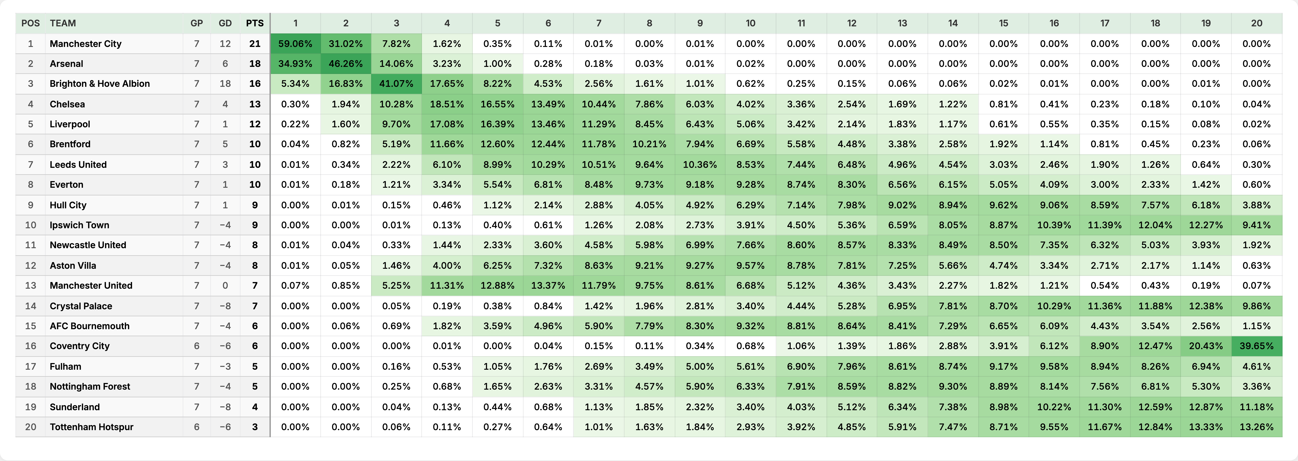
Premier League 2026/27: every team, every position
THE DELIVERABLE · AS OF 19 OCTOBER 2026
1st + 2nd + 3rd + 4th →
18th + 19th + 20th →
TOP 4
BOTTOM 3
99.5%
0.0%
98.5%
0.0%
80.9%
0.0%
31.0%
0.3%
28.6%
0.2%
17.7%
0.7%
8.7%
2.2%
4.7%
4.4%
0.6%
17.6%
0.1%
33.7%
1.8%
10.9%
5.5%
3.9%
17.5%
0.7%
0.2%
34.1%
2.6%
7.2%
0.0%
72.6%
0.7%
19.8%
0.9%
15.5%
0.2%
36.6%
0.2%
39.4%
Straight from the live dashboard: % chance of finishing in each position, from 10,000 simulated seasons. football-league-simulator.streamlit.app

Slide 15
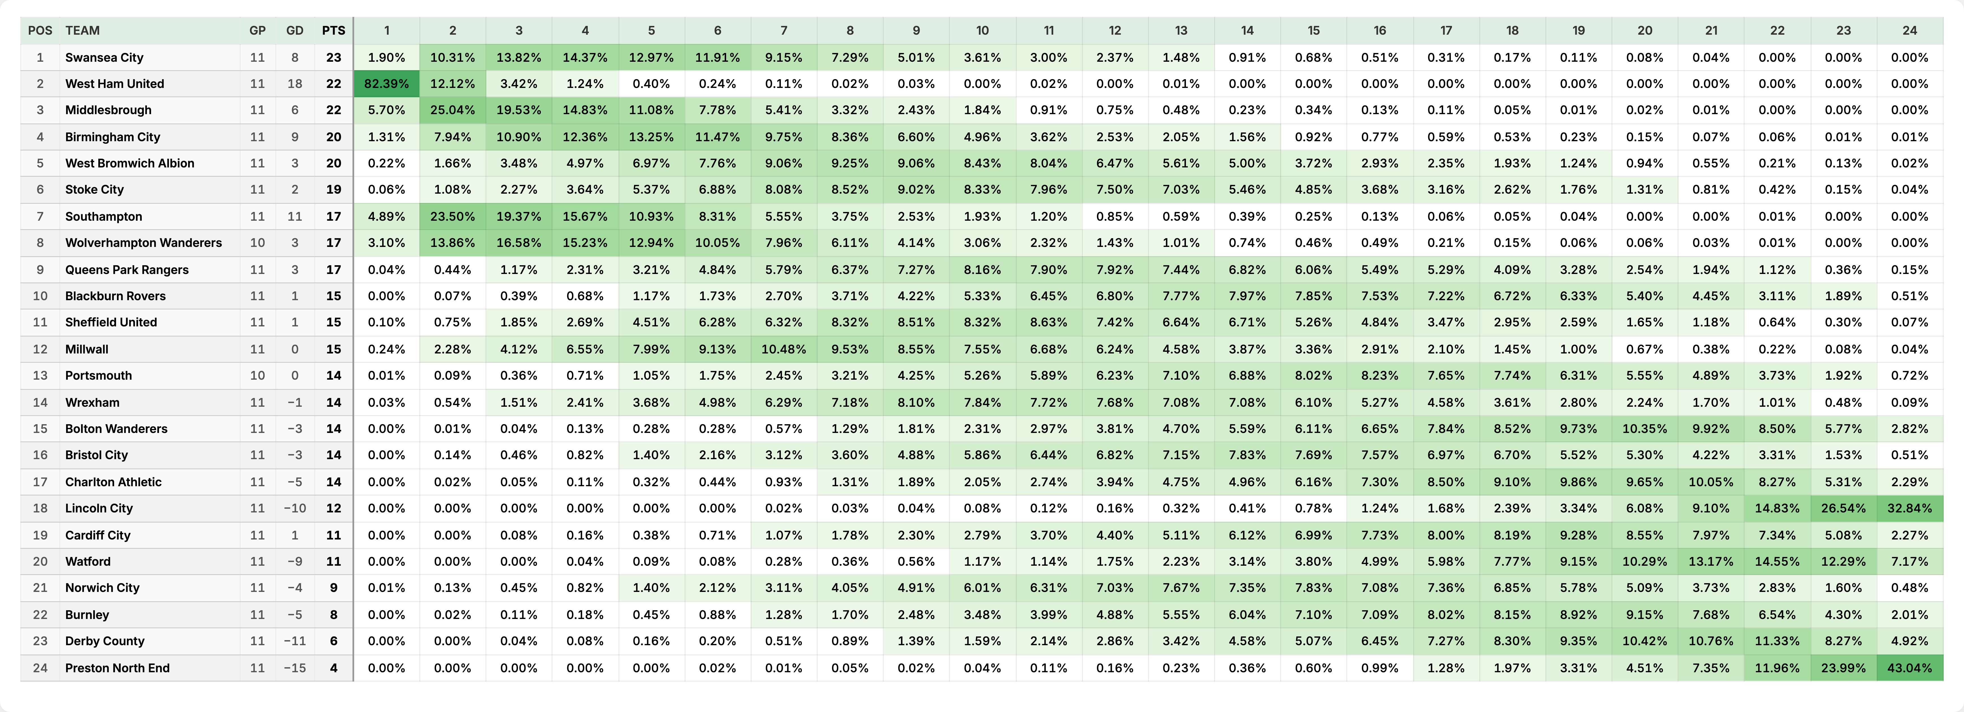
Championship 2026/27: every team, every position
THE TABLE VS THE MODEL · AS OF 19 OCTOBER 2026
Straight from the live dashboard: % chance of finishing in each position, from 10,000 simulated seasons. football-league-simulator.streamlit.app

Slide 16
Southampton: 7th in the table, #2 on the ratings
THE TABLE VS THE MODEL · AS OF 19 OCTOBER 2026
# | Team | GP | GD | Pts
1 | Swansea City | 11 | +8 | 23
2 | West Ham United | 11 | +18 | 22
3 | Middlesbrough | 11 | +6 | 22
4 | Birmingham City | 11 | +9 | 20
5 | West Bromwich Albion | 11 | +3 | 20
6 | Stoke City | 11 | +2 | 19
7 | Southampton (−4) | 11 | +11 | 17
8 | Wolves | 10 | +3 | 17
9 | Queens Park Rangers | 11 | +3 | 17
10 | Blackburn Rovers | 11 | +1 | 15
11 | Sheffield United | 11 | +1 | 15
12 | Millwall | 11 | 0 | 15
13 | Portsmouth | 10 | 0 | 14
14 | Wrexham | 11 | -1 | 14
15 | Bolton Wanderers | 11 | -3 | 14
16 | Bristol City | 11 | -3 | 14
17 | Charlton Athletic | 11 | -5 | 14
18 | Lincoln City | 11 | -10 | 12
19 | Cardiff City | 11 | +1 | 11
20 | Watford | 11 | -9 | 11
21 | Norwich City | 11 | -4 | 9
22 | Burnley | 11 | -5 | 8
23 | Derby County | 11 | -11 | 6
24 | Preston North End | 11 | -15 | 4
7th
#2
2nd
in the table: 6W 3D 2L = 21 pts, minus 4 = 17
on the ratings (attack minus defence), with the 2nd-best GD: +11
most likely finish: 82% chance of the top six
The deduction costs them 17 percentage points of automatic-promotion chance: 44% → 27%. The ratings ignore it; it lives in the starting table.
Dark green: automatic promotion · lighter: play-offs

Slide 17
Swansea City: top of the table, 1.9% to win it
THE TABLE VS THE MODEL · CHAMPIONSHIP · AS OF 19 OCTOBER 2026
# | Team | GP | Pts | Title chance | 2025/26
1 | Swansea City | 11 | 23 | 1.9% | 11th
2 | West Ham United | 11 | 22 | 82.4% | Relegated
3 | Middlesbrough | 11 | 22 | 5.7% | 5th
4 | Birmingham City | 11 | 20 | 1.3% | 10th
5 | West Bromwich Albion | 11 | 20 | 0.2% | 19th
6 | Stoke City | 11 | 19 | 0.1% | 17th
7 | Southampton | 11 | 17 | 4.9% | 3rd
8 | Wolves | 10 | 17 | 3.1% | Relegated
1.9%
82%
Swansea City: 1st today, 11th last season
West Ham United: 2nd, 1 point behind, relegated from the Premier League
Why? West Ham United came down from the Premier League, and their goal difference is +18, the best in the league, against Swansea City's +8. An 11-game start can't outweigh that, and with 35 to go, 1 point is one result.
Same story in Ligue 1: Lyon top (9%, 4th last season), Paris Saint-Germain 2nd but 71% favourites as reigning champions.

Slide 18
The 2026/27 title race, one run per day
WATCHING IT MOVE
AFTER 2 GAMES → TODAY
Man City
Brighton 3–0 Arsenal
Arsenal win 1–0 at Forest
41% → 59%
City win 3–0 at Liverpool
Arsenal
44% → 35%
Brighton
1% → 5%
Others
14% → 1%

Slide 19
Last season, called on 9 March 2026
04 · DOES IT WORK?
Team | Model on 9 March | Actual finish
Arsenal | 93.5% to finish 1st | 1st, champions | ✓
Man City | 91.4% to finish 2nd | 2nd | ✓
Man United | 45.3% to finish 3rd | 3rd | ✓
Burnley | 77.0% to finish 19th | 19th, relegated | ✓
Wolves | 79.5% to finish 20th | 20th, relegated | ✓
THE SURPRISE
Chelsea
97%
11th
chance of finishing 3rd–7th
actual finish (0.07% chance)
On goals, Chelsea looked like a top-six side. The drop only showed up in the results later, which is why richer data is next on the list.
The middle was a genuine toss-up: 4th place on 9 March was Chelsea 26.3%, Aston Villa 26.0%, Man United 25.3%. Aston Villa took it: the model's second pick, well inside the spread.

Slide 20
When it says 70%, does it happen 70% of the time?
CHECKING CALIBRATION
39k
probabilities scored: 4 leagues, 239 league-days, March–May 2026
Close match. The bars track each other closely: calls of 70–85% came in 81% of the time.

Slide 21
The model was easy. So much went wrong running it
PROBLEMS I HIT IN PRODUCTION
Source | What it calls the same club
ESPN (scraped table) | Internazionale
football-data.org (fixtures) | FC Internazionale Milano
the-odds-api (odds) | Inter Milan
Cloud IPs get blocked
ESPN's firewall served an empty challenge page to GitHub Actions but not to my laptop. Fix: a real headless browser.
A regex ate Schalke 04
Team codes with digits (“S04”) weren't stripped. Only surfaced when Schalke were promoted.
Unmapped, one club becomes three teams, each with a third of its data. No error, no warning: just quietly wrong numbers.
Fixtures that never matched
A name mismatch left two promoted Eredivisie sides with zero fixtures, so they sat on 100% for their current position.
In production, the bugs came from the data pipeline, not from the statistics.
Runtime creep
A 9th league pushed the daily job past 30 minutes. Concurrency, rate pacing, and parallel simulation got it under 3.

Slide 22
Where the model goes next
WHAT'S NEXT
Goals are a slow signal
Everything assumes ‘business as usual’
0–5 events a match. A team can play better for weeks before the scoreline shows it.
A new manager or a key injury shifts real strength faster than a goals rating can follow.
NEXT Richer inputs: xG, xThreat, and tracking data like SkillCorner's (off-ball runs, pressing, physical output)
NEXT Event flags, faster-reacting ratings, market weight that adapts
Independent goals
The market only reaches priced games
Low scorelines (0–0, 1–1) happen a bit more often than independence predicts.
What bookmakers know shapes only the 21 priced matches; the other 290 use the model alone.
NEXT Dixon–Coles low-score correction
NEXT Learn team strength from the odds, so it carries into every fixture

Slide 23
Why the same recipe breaks for rugby
A NOTE FOR OTHER SPORTS
One scoring event?
Football: goals. Rugby: tries, conversions (conditional on a try), penalties, drop goals. Four correlated processes.
Three outcomes?
Bonus points (4+ tries, or losing by ≤7) turn 3 results into 20. No 7×7 grid shortcut: each match needs its own Monte Carlo layer.
Uniform home advantage?
Measured on English Premiership data: +1.15 tries at home, −0.06 penalties. One constant would misapply it.
A market to lean on?
Thin rugby markets and no clean API: everything scraped, nothing to blend with or validate against.
Football answers all four favourably. That's the exception, not the rule: check these before porting the model to a new sport.

Slide 24
Four things to take away
WRAPPING UP
01
Report a distribution, never a rank
02
Simple models, done rigorously
A single simulated season is one sample. The spread is the answer.
Poisson, shrinkage, and market odds: simple pieces that, combined, are reasonably well calibrated.
03
Name every assumption
04
The model is the easy part
Independence, business-as-usual, tie-breaks. Re-check each before reusing the model elsewhere.
Name mapping, missing fixtures, and blocked scrapers are where the time goes.

Slide 25
Questions?
05 · Q&A
Ask anything: the model, the code, the data sources, or how to build your own.

Slide 26

LET'S CONNECT
Thank you!
Victoria Friss de Kereki
Scan to connect on LinkedIn
Connect with me on LinkedIn: I post every new model, article, and dashboard update there.
LIVE DASHBOARD
football-league-simulator.streamlit.app
CODE (GITHUB)
github.com/vickyfriss/football-league-predictions
ARTICLES (MEDIUM)
medium.com/@vickyfrissdekereki
LINKEDIN
linkedin.com/in/victoria-friss-de-kereki
linkedin.com/in/victoria-friss-de-kereki

